Slide 1
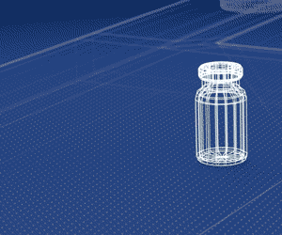
Don't miss the world premiere of SCHOTT’s new kind of pharmaceutical vial.
Have you ever wondered how to safely package sensitive drugs even with high pH-values? Well, we might have just the right solution for you!
We would like to invite you to the world premiere of the new kind of pharmaceutical vial and join our exclusive live keynote speech on:
April 13th at 9:00 am and 3:00 pm CET
Pre-Register now to be eligible to participate in the keynote speech.
REGISTER NOW
The live presentation will be held in the Pharma world of innovations – SCHOTT’s very own digital innovation experience. Please ensure you get your registration validated in advance and be ready on the day.
Furthermore, we would like to invite you to join our experts for individual chat discussions after the speech, as well as to explore the digital experience of the new kind of pharmaceutical vial.
You feel like you can’t wait any longer? In the meantime, feel free to experience our other innovations on the Pharma world of innovations.
EXPLORE NOW
We look forward to welcoming you!
Your SCHOTT Pharmaceutical Systems team

