Slide 1
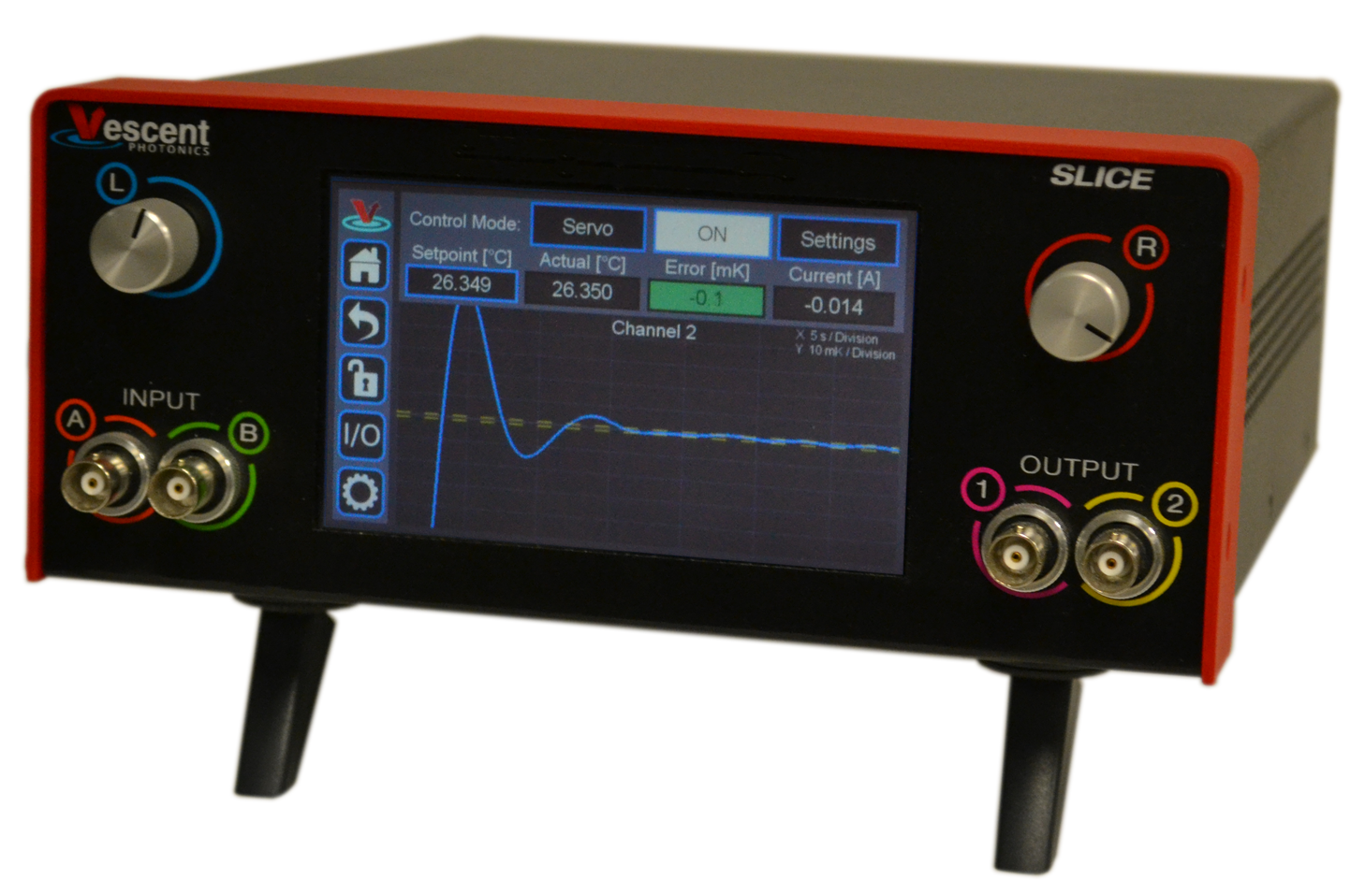
High-Performance Temperature Control
Whole ad links to https://www.vescent.com/products/electronics/slice/slice-qt-four-channel-temperature-controller/
SLICE-QTC Temperature Controller
Precise temperature regulation with the SLICE-QTC
Sub-millikelvin stability and set-point resolution
Touch-screen and USB interface
Slew rate control
Simple to set up and use
Economical 4-channel design
Except links to home page & info email.
www.vescent.com • info@vescent.com

